Slide 1
Adjusted vs Unadjusted Results
What is the difference and why does it matter?

Slide 2

Knowledge Check
An example
Unadjusted
(crude, observed,…)
Adjusted
(posterior, LS mean,…)
Team A
Team B
We observed a 64% response on active and 58% on control, giving odds of 1.74 and 1.39 respectively.
This gave an odds ratio of 1.25 (greater odds of response on active than control).
A logistic regression model was used to estimate the odds ratio of active over placebo. The model covariates included age and baseline severity.
This gave an odds ratio of 1.28 (greater odds of response on active than control).
Which Odds Ratio estimate is correct?

Slide 3
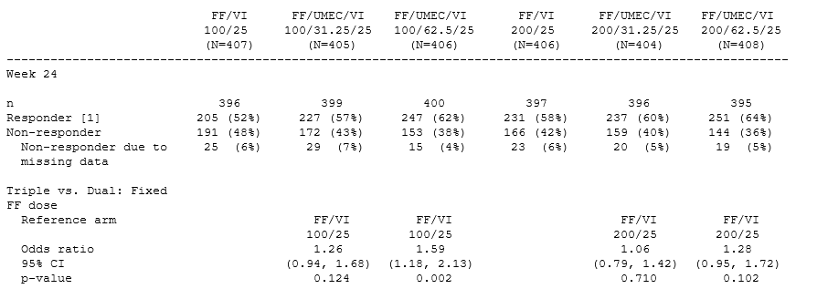
CAPTAIN Example
Odds Ratio
Team A
Control
Active
Odds Ratio =
Odds Active
Odds Control

Slide 4
CAPTAIN Example
Odds Ratio
Team A
Control
Active
Odds Ratio =
1.25 (0.91, 1.88)
Team B
Adjusted Odds Ratio = 1.28 (0.95, 1.72)

Slide 5
Unadjusted vs Adjusted
Unadjusted
(crude, observed,…)
Adjusted
(posterior, LS mean,…)
Unadjusted/crude/observed results
Easily calculated by hand
Do not account for factors other than treatment group in our analysis
All variability in the data is attributed to treatment
Adjusted / LSMean / Posterior results
Calculated by statistical analyses methods
Allow us to account for factors other than treatment in our analysis
Variability due to covariates is accounted for, usually leading to a more precise treatment effect estimate

Slide 6

Covariates – why do they matter?

Slide 7

Covariates: an overview
What?
The characteristic present at baseline which is known to impact the endpoint (stratification factors, rare characteristics)
Impact?
Estimate of the effect due to treatment alone
Precision associated with that estimate (more bang for your buck)!
Why?
Prevents variability being falsely attributed to the treatment group
Enables inferences assuming treatment groups are “balanced” with respect to these characteristics
Warning!
Different covariate combinations give different results!
Reviewing competitor results – did they use the same covariates?
Decide at the trial design stage – otherwise credibility may be in doubt…

Slide 8
Motivating Example
Roxadustat, Fibrogen
Roxadustat
Oral treatment for anaemia associated with chronic kidney disease (CKD)
Key safety endpoints tested for non-inferiority and superiority
Time to first MACE: MACE (major adverse cardiovascular events), a composite endpoint including all-cause mortality, myocardial infarction, and stroke
Time to first MACE+: MACE+ includes MACE, unstable angina requiring hospitalization, and congestive heart failure requiring hospitalization
Time to all-cause mortality
ASN Conference in 2019
The risk of MACE, MACE+ and all-cause mortality in Roxadustat patients was comparable to placebo

Slide 9
Roxadustat CV Safety Results…all looks well
 | Analyses from ASN 2019 & Dec 2020 publication
 | HR (95% Confidence Interval)
Non-Dialysis (OLYMPUS, ANDES, ALPS N=4,270); ITT
MACE | 1.08 (0.94, 1.24)
MACE+ | 1.04 (0.91, 1.18)
ACM | 1.06 (0.91, 1.23)
Hypothesis test of non-inferiority to placebo
Null: HR ≥ 1.25
Alternative: HR < 1.25
Nov 2019
ASN conference
…
Dec 2020
1Q2021
Manuscripts:
Pooled CV Analysis for ID subgroup
OLYMPUS study
Manuscripts:
ALPS study
ANDES study
HIMALAYAS study
April 2021
FibroGen press release & investor call

Slide 10
Roxadustat CV Safety Results…additional comments
Enrique Conterno, Chief Executive Officer, FibroGen
“…preparing for the upcoming FDA Advisory Committee meeting, we became aware that the primary cardiovascular safety analyses included post-hoc changes to the stratification factors.”
Mark Eisner, Chief Medical Officer, FibroGen
“….the cut point for GFR based on hemoglobin and definition of geographic region were changed after unblinding.…. there were some additional variables of sex, race and body mass index that were added…”

Slide 11
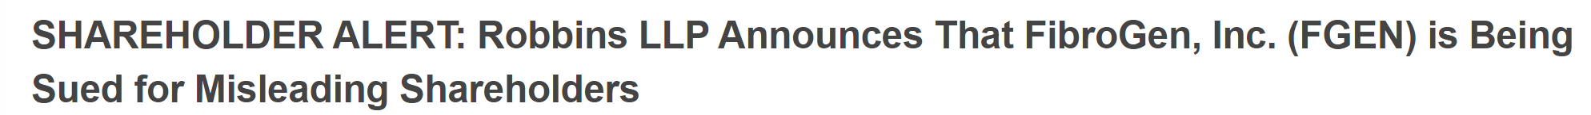
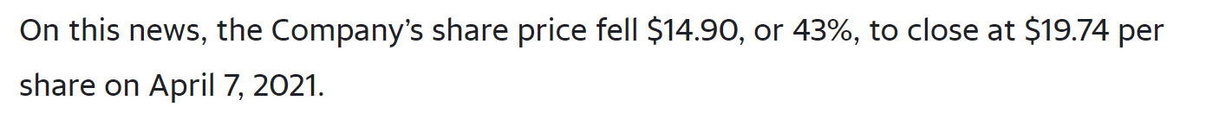


What’s the Impact on the Roxadustat CV Safety Results?
Every Pre-Specified Analysis Looks Less Favorable for Roxadustat
 | Analyses with post-hoc stratification factors from ASN 2019 & Dec 2020 publication | Analyses with pre-specified stratification factors
 | HR (95% Confidence Interval) | HR (95% Confidence Interval)
Non-Dialysis (OLYMPUS, ANDES, ALPS N=4,270); ITT
MACE | 1.08 (0.94, 1.24) | 1.10 (0.96, 1.27)
MACE+ | 1.04 (0.91, 1.18) | 1.07 (0.94, 1.21)
ACM | 1.06 (0.91, 1.23) | 1.08 (0.93, 1.26)

Slide 12
Key Messages
Unadjusted (Observed) and Adjusted Results
What do you need to do?
Both unadjusted and adjusted results are valid, but they tell you different things
When presenting results,
If primary or secondary analyses, usually the adjusted results will be most appropriate
Both randomisation and covariates help control for differences between groups
When planning work, speak up if there are factors that should be considered
When reviewing work, consider if covariates were used in the analysis
Prespecifying analysis matters as it provides credibility
If exploratory (or ad-hoc), it may not be clear. If in doubt, ask your statistician

